Slide 1
Predicting and Analyzing Fuel Efficiency
Progress Meeting
Esslam Mumen

Slide 2
Table of Contents
What we are going to talk about:
An overview of what I chose for my Capstone Project.
Explaining the source of my data.
The data cleaning process.
Some data analysis.
Predictive model.
A look at the interactive web frame for the model
Q&A /Discussion points.

Slide 3
01
What is my Capstone About?

Slide 4
What does it entail?
My project idea mainly focuses on contributing to the automotive industry by:
Creating data visualizations for analyzing fuel-efficient cars and savings on different models.
Assisting consumers in finding the car features which serve their need to save on fuel consumption and to reduce their expenditure on fuel.
Helping consumers to minimize their carbon footprint by comparing car components with greenhouse gas emissions.

Slide 5
02
The Data

Slide 6
Data Source
The data was prepared by the US Department of Energy’s Office of Energy Efficiency & Renewable Energy.
It is the result of vehicle testing done at the Environmental Protection Agency’s National Vehicle and Fuel Emissions Laboratory in Ann Arbor, Michigan., as well as by other vehicle manufacturers who are in partnership with EPA.
The data is available at https://www.fueleconomy.gov/feg/download.shtml, where car data is split into three categories: “Fuel Economy Guide”, “EPA Green Vehicle Guide”, and “SmartWay Vehicle List’.’

Slide 7
How I Cleaned the Data
Concatenating 35 excel files across the years 2013-2023 and across different car categories depending on fuel efficiency.
Renaming the columns in order to make them more clear and concise.
Fixing columns with several data types by combining them into one. Some columns had numbers and ranges of numbers stored in strings.
Fixing rows with different datatypes
Forming indeces for the dataset.

Slide 8
01
02
03
Fuel Economy Guide
Green Vehicle Data
SmartWay Vehicle Data
The Three Categories Based on Fuel Consumption
For providing fuel economy estimates on typical cars, namely, the ‘city’ and ‘highway’ estimates.
For cars that are more efficient and less polluting, including gas, electric, and hybrids.
A certification for the top 20%, cleanest and most efficient vehicles.

Slide 9
03
The Data Analysis

Slide 10
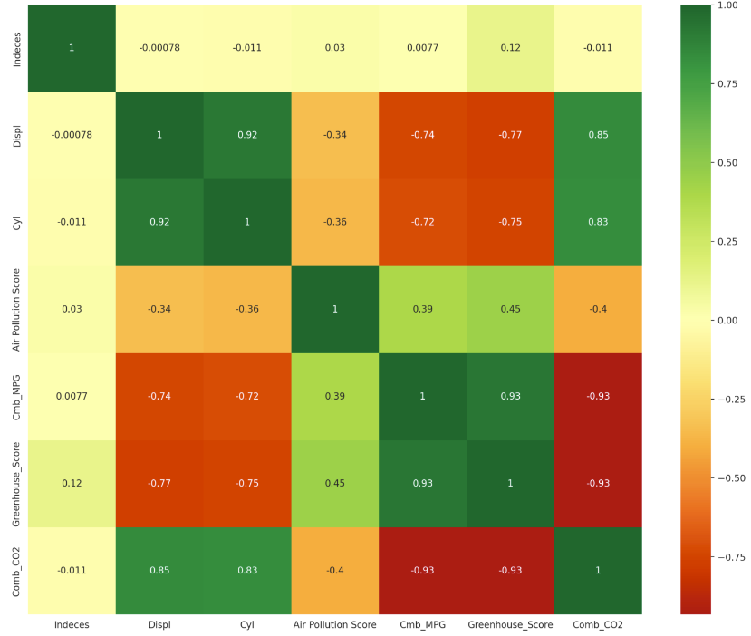
The Correlation Matrix
As evident, the higher the cylinder or displacement for
the car, the more the carbon emissions.
There is also an inverse relationship between mpg and
Greenhouse emissions.
Displacement has a direct correlation with cylinders, since
as the cylinder increase, the engine volume increases as well.
Interestingly, the carbon emission metric is directly correlated
with the greenhouse emission but not the air pollution score.

Slide 11
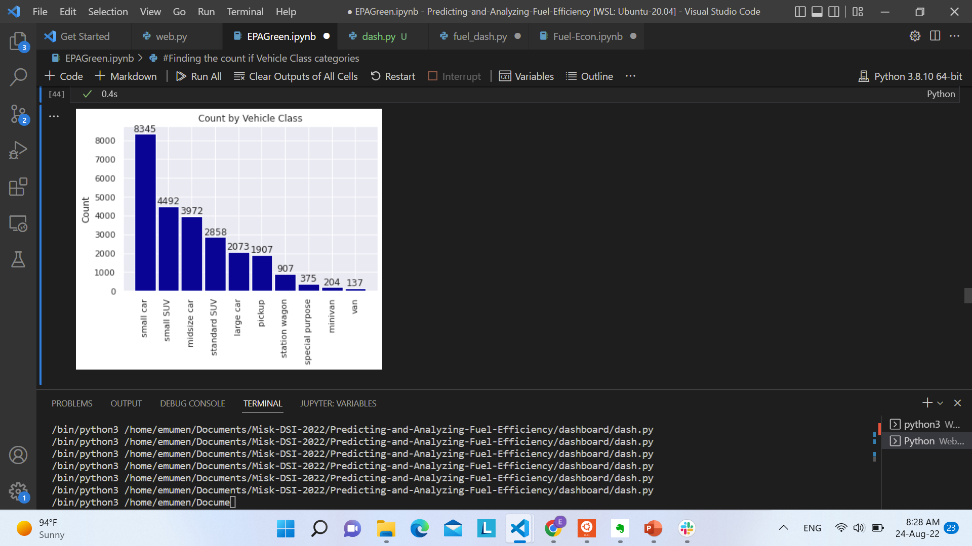
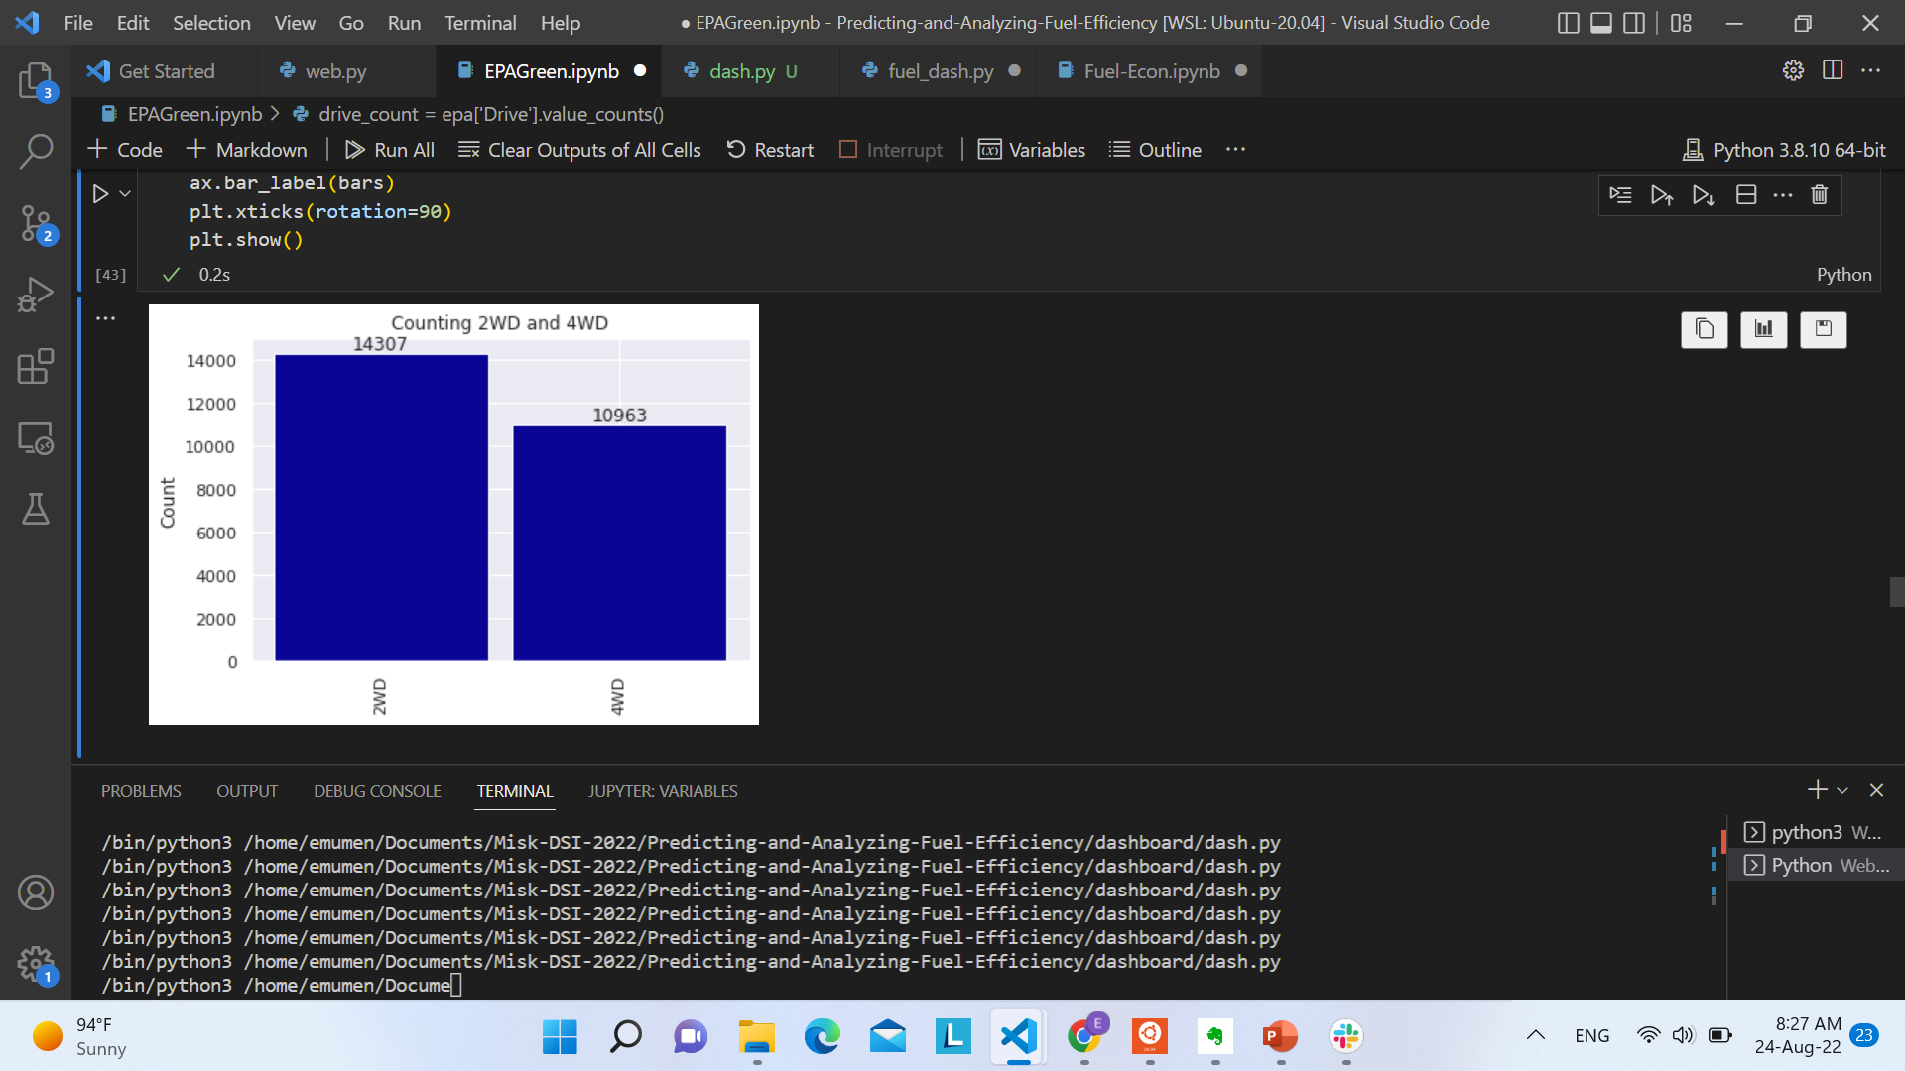
The Count for Different Categories

Slide 12
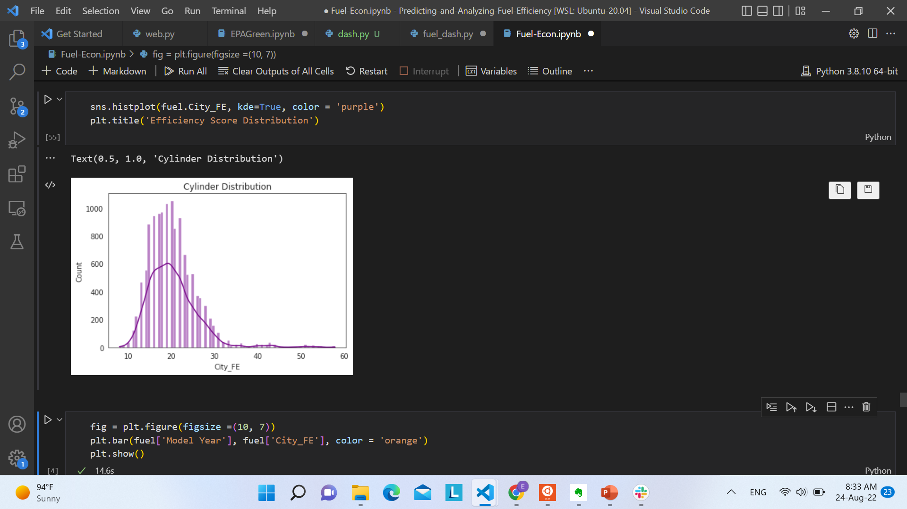
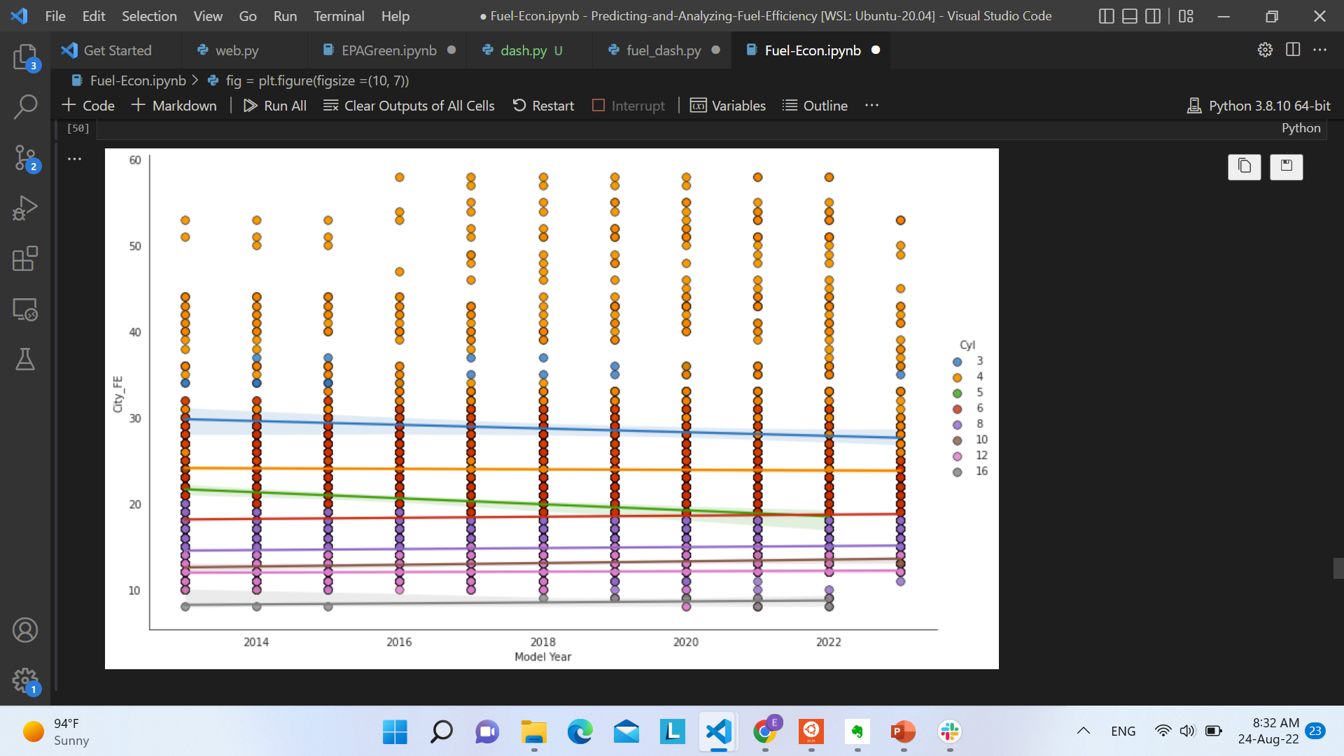
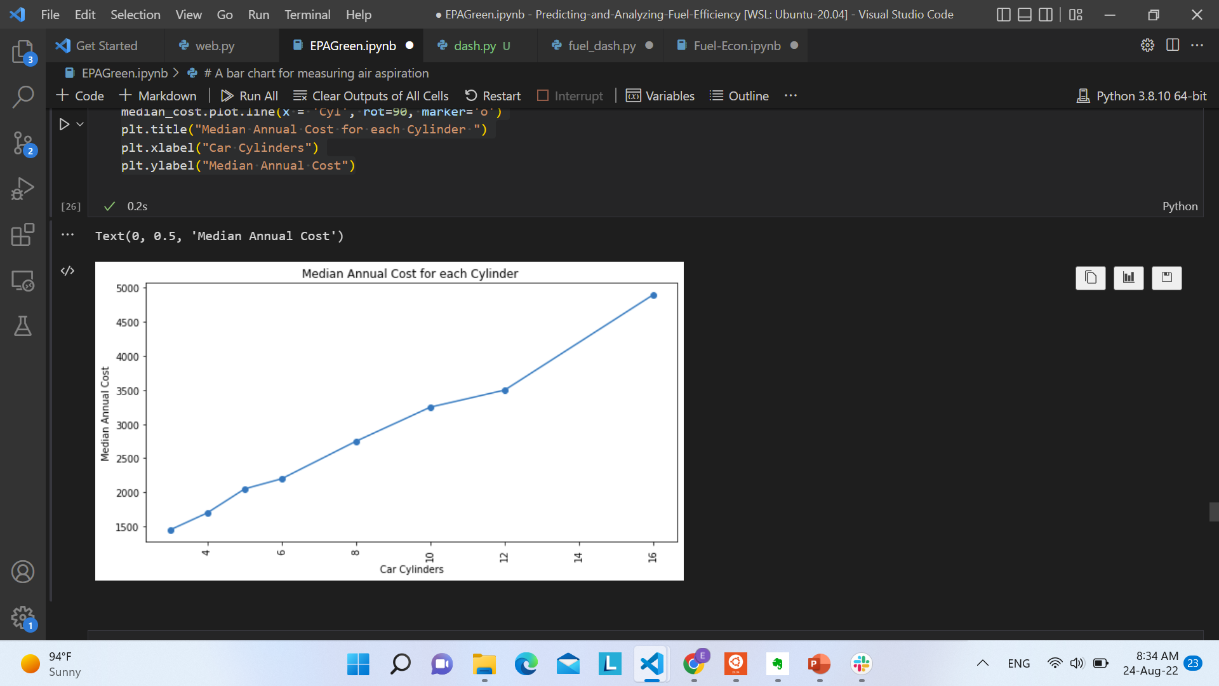
Analyzing the Miles Per Gallon Feature

Slide 13
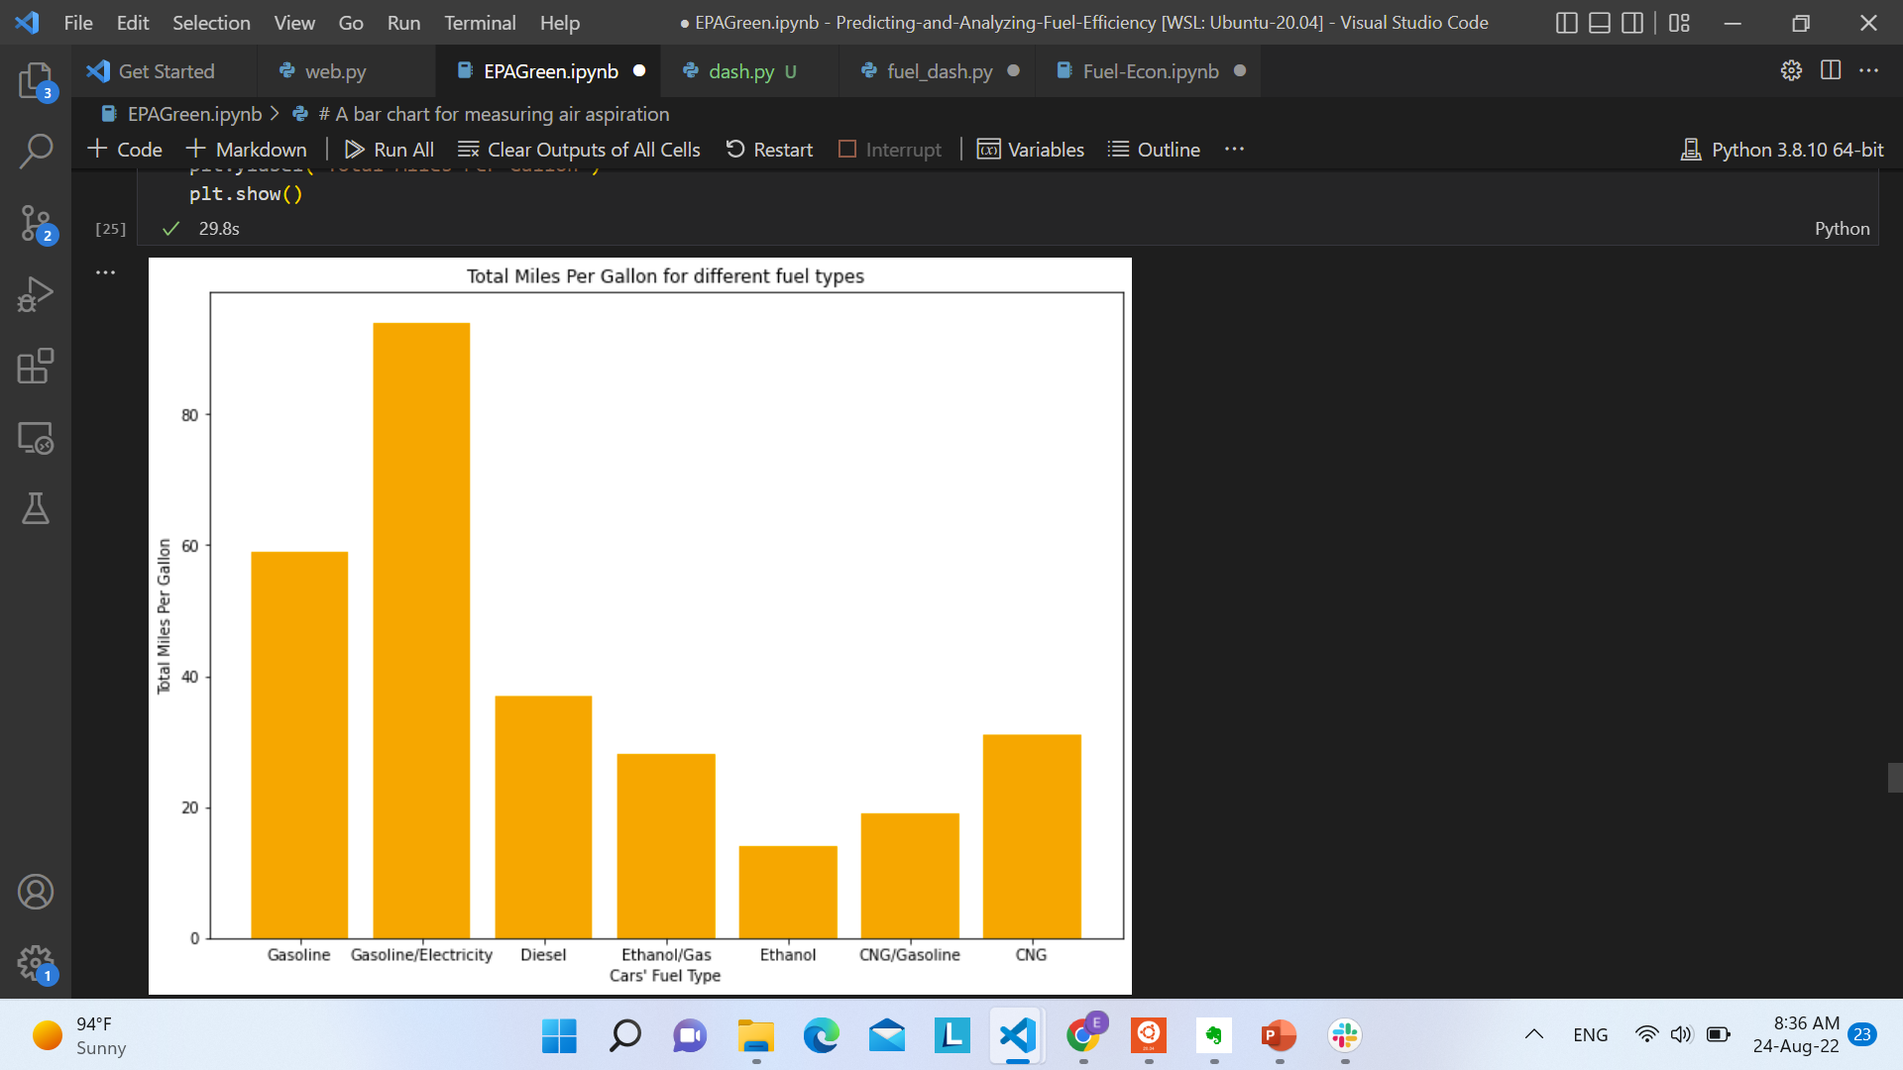
Fuel Types and their Effect on Mileage
Ethanol is the least efficient fuel type out of all options.
Gasoline is the most efficient single fuel source.
A gasoline/electricity hybrid is the best option, with an average of over 80 miles per gallon of

Slide 14
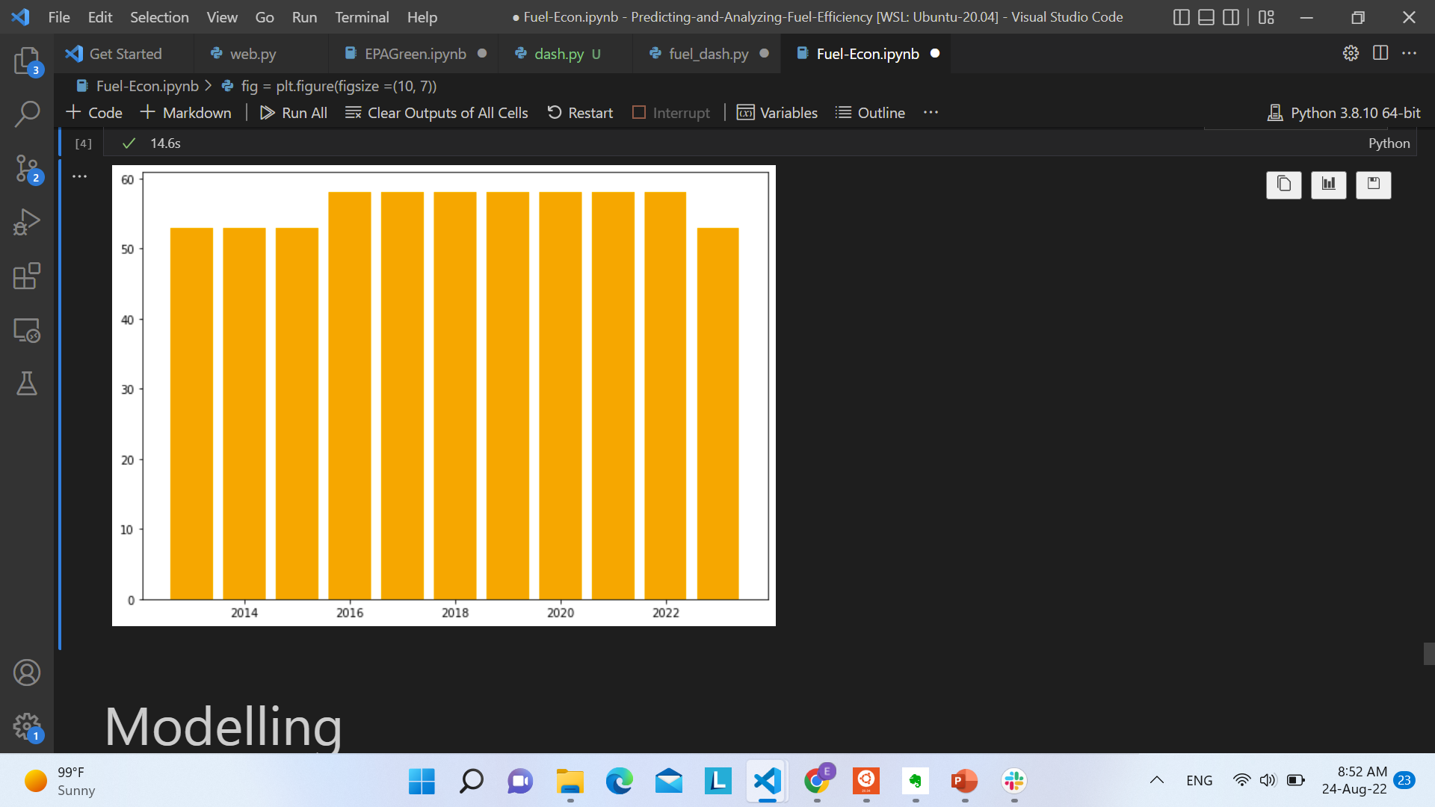
Fuel Efficiency Score from 2013-2023
The score was constant from 2013 – 2015.
It improved in 2016 and has stayed the same since.
The change in the 2023 data is likely because that year is not complete, since cars from this year are still under production.

Slide 15
03
The Predictive Model

Slide 16
Predicting Mileage Based on Car Components
Description: The model aims to take car features like in order to predict the miles per gallon for a car accordingly.
The steps taken to develop the model:
1. 0.8, 0.2 train-test data split.
2. One hot encoded the nominal features.
3. Combined them into a preprocessing pipeline.
4. Created a GBM estimator for a gradient boosting model.
5. Created a random search object.
6. Defined four hyperparameter, namely n_estimator, learning rate, max depth, and min child weight.

Slide 17
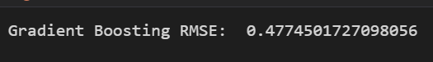
In Conclusion
The model achieved a low score of around 0.47745.
The features which were most able to predict mileage per gallon were the gas emissions, displacement, vehicle class, and transmission.
A hybrid car is the most optimal for maximized fuel usage, while ethanol car is the least optimal.
Cylinders are positively skewed when plotted against fuel efficiency scoring metric.
Small and two-wheel drive cars are the most widespread.
Fuel efficiency score has been constant, before improving for car models from 2016 onwards.

Slide 18
Thank You! Q&A and Discussion Points

